Slide 1
CSE 574 Lecture 6: Markov Models and Markov Decision Processes
Professor: Stephanie Gil
Email: sgil@asu.edu (Office hours M 12-1pm BYENG 386)
TAs: Sushmita Bhattacharya sbhatt55@asu.edu (Office hours M 5-6 BYENG 392)
Weiying Wang wwang239@asu.edu (Office hours Th 2:30-3:30 BYENG 392)

Slide 2
Pop Quiz Today
This is a closed book quiz. No notes, no phones, no textbook. Please put everything away.
You will have 15 minutes to complete the quiz
Good luck!

Slide 3
Last Time:
HW 2 due this Friday– any questions?
Please bring them up early
Midterm moved to Oct 3rd in class
Last time: Constraint Satisfaction Problems
Identification problems
Path was not important, only the final assignment
Solution satisfies constraints
This time: Markov Models and Markov Decision Processes!
Reading Sutton and Barto text “Reinforcement Learning, An Introduction” Second Edition (2017), chapter 3 (available online)
Next time: Dynamic Programming and Optimal Control Vol 1
Provided by Dimitri Bertsekas on our Blackboard site!
Please note that this material is copyrighted and not authorized for sharing or posting outside of this class

Slide 4
Markov Decision Problems (MDP)
A few notes about MDPs:
Sequential decisions – here, actions don’t only influence immediate awards but also subsequent states and future rewards
MDPs involve delayed reward and the need to tradeoff immediate and delayed reward
MDPs are a mathematically idealized form of the reinforcement learning problem for which precise theoretical statements can be made

Slide 5
Markov Models, Markov Chains, MDPs
Definition Markov Model – A stochastic model used to model randomly changing systems.
Markov property - future states depend only on the current state and not on events that occurred before it.
This assumption enables reasoning and computation that would otherwise be intractable
 | System State Fully Observable | System State Partially Observable
System Autonomous | Markov Chain | Hidden Markov Model
System Controlled | Markov Decision Process | Partially Observable MDP
Next few classes…

Slide 6
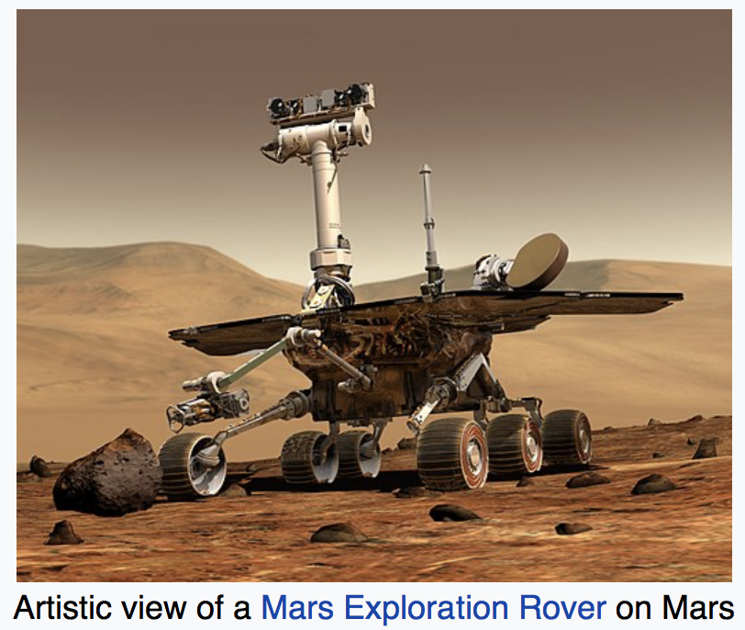

Markov Models
Example: Mars Exploration Rover Spirit Wheel
Source: Cornell Engineering Magazine Spring 2004
Source: Wikipedia

Slide 7

Markov Models
Example: Mars Exploration Rover Spirit Wheel
p=0.5
Failed
Nominal
p=0.5
p=0.8
p=0.2
Probabilities sum to 1
S={Failed, Nominal} states
p(s’|s) state transitions
Source: Wikipedia

Slide 8
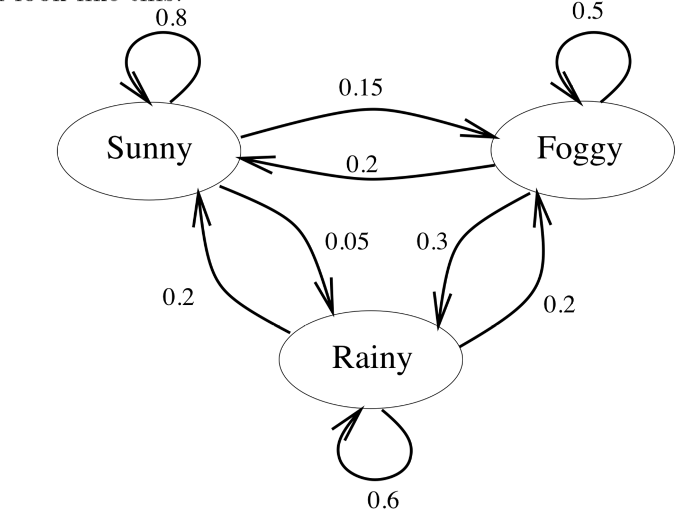
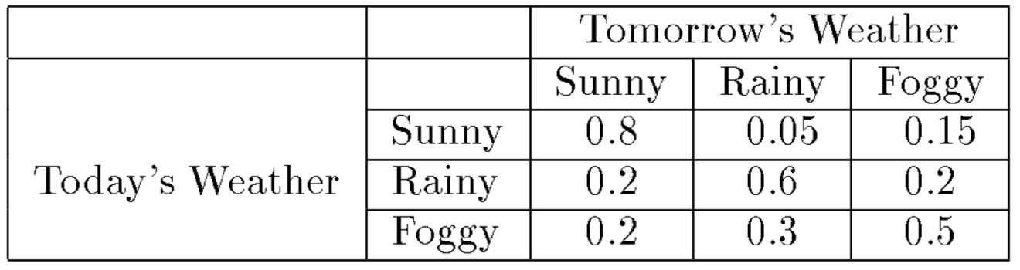
Markov Models (cont)
Example 2: Weather prediction
Questions we might want to ask using a Markov model:
We want to know p(s_{n}|s_{n-1},s_{n-2},…,s₁)
Given that today is sunny, what is the probability that tomorrow is sunny and the day after is rainy? i.e. p(s₂=Sunny, s₃=Rainy | s₁=Sunny)?
Markov Property helps us here!

Slide 9
Can we Introduce Actions?
If the agent can select actions, this becomes a Markov Decision Process (MDP)
Agent - environment interface
Agent → selects actions
Environment → gives rewards
Objective: agent seeks to maximize rewards over time through its choice of actions

Slide 10
Agent-Environment Interface
A trajectory here, or sequence, looks like this:
S₀, A₀, R₁, S₁, A₁, R₂,…

Slide 11
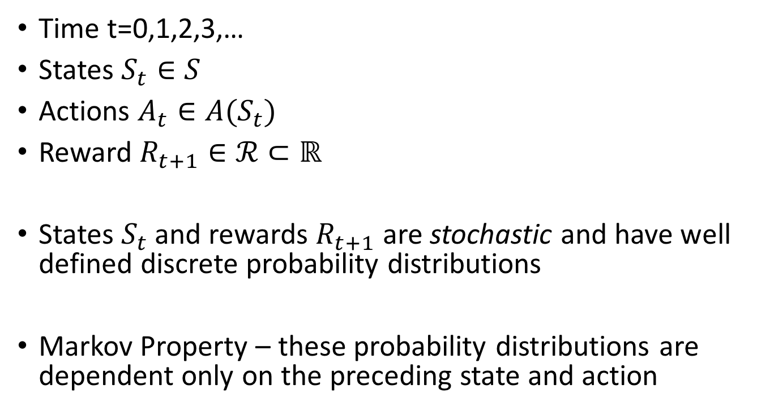
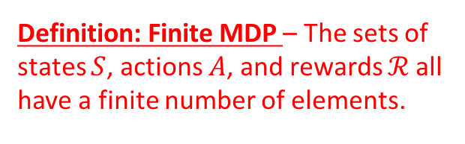
Modeling a Markov Decision Process
Time t=0,1,2,3,…
States $S_{t}∈S$
Actions $A_{t}∈A(S_{t})$
Reward $R_{t+1}∈ℛ⊂ℝ$
States $S_{t}$ and rewards $R_{t+1}$ are stochastic and have well defined discrete probability distributions
Markov Property – these probability distributions are dependent only on the preceding state and action
Definition: Finite MDP – The sets of states $S$, actions $A$, and rewards $ℛ$all have a finite number of elements.

Slide 12
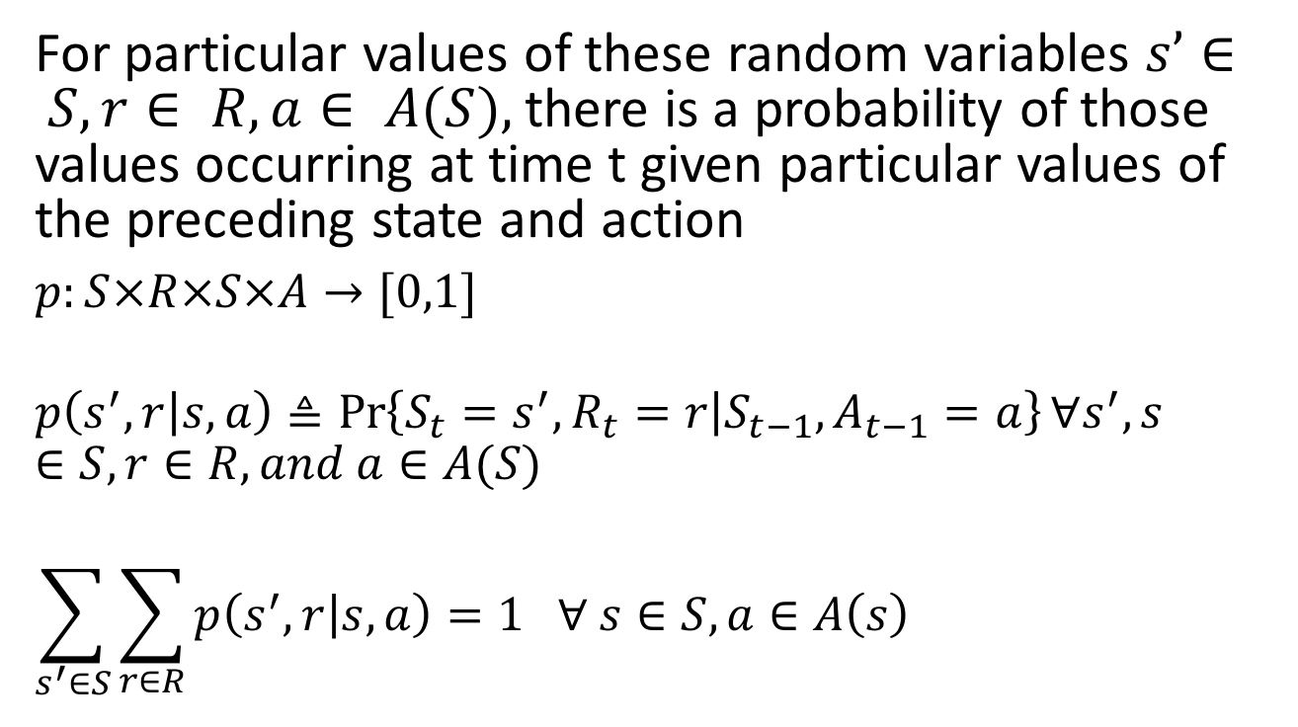
Modeling a Markov Decision Process (cont)
For particular values of these random variables $s’∈ S, r∈ R, a∈ A(S),$there is a probability of those values occurring at time t given particular values of the preceding state and action
$p:S×R×S×A→[0,1]$
$$p\left(s^{′},r | s,a\right)≜\operatorname{Pr}\left\{S_{t}=s^{′}, R_{t}=r | S_{t−1},A_{t−1}=a\right\}∀s^{′},s∈S, r∈R, and a∈A(S)$$
$$\sum_{s^{′}∈S}{\sum_{r∈R}{p\left(s^{′},r | s,a\right)=1 ∀ s∈S, a∈A\left(s\right) }}$$
Dynamics of the finite MDP
All possible states and rewards accessible from s with action a

Slide 13
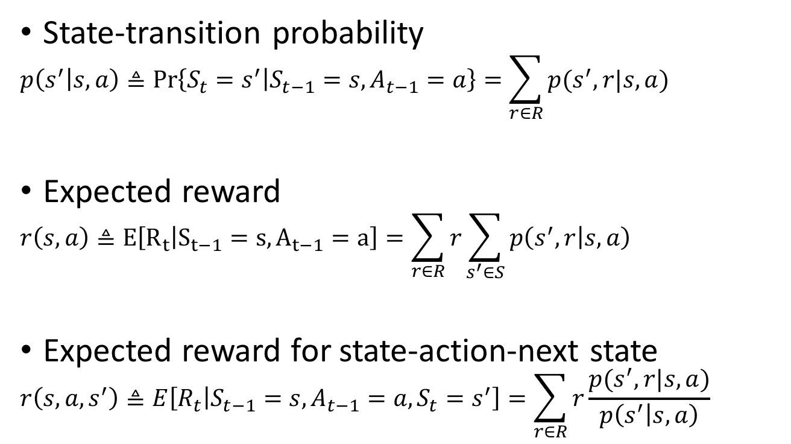
Important Quantities for MDPs
State-transition probability
$$p\left(s^{′} | s,a\right)≜\operatorname{Pr}\left\{S_{t}=s^{′} | S_{t−1}=s,A_{t−1}=a\right\}=\sum_{r∈R}{p(s^{′},r|s,a)}$$
Expected reward
$$r\left(s,a\right)≜E\left[R_{t} | S_{t−1}=s,A_{t−1}=a\right]=\sum_{r∈R}{r}\sum_{s^{′}∈S}{p\left(s^{′},r | s,a\right)}$$
Expected reward for state-action-next state
$$r\left(s,a,s^{′}\right)≜E\left[R_{t} | S_{t−1}=s, A_{t−1}=a, S_{t}=s^{′}\right]=\sum_{r∈R}{r}\frac{p(s^{′},r|s,a)}{p\left(s^{′} | s,a\right)}$$
You will be asked to find these values… we’ll be covering this for the next few lectures

Slide 14
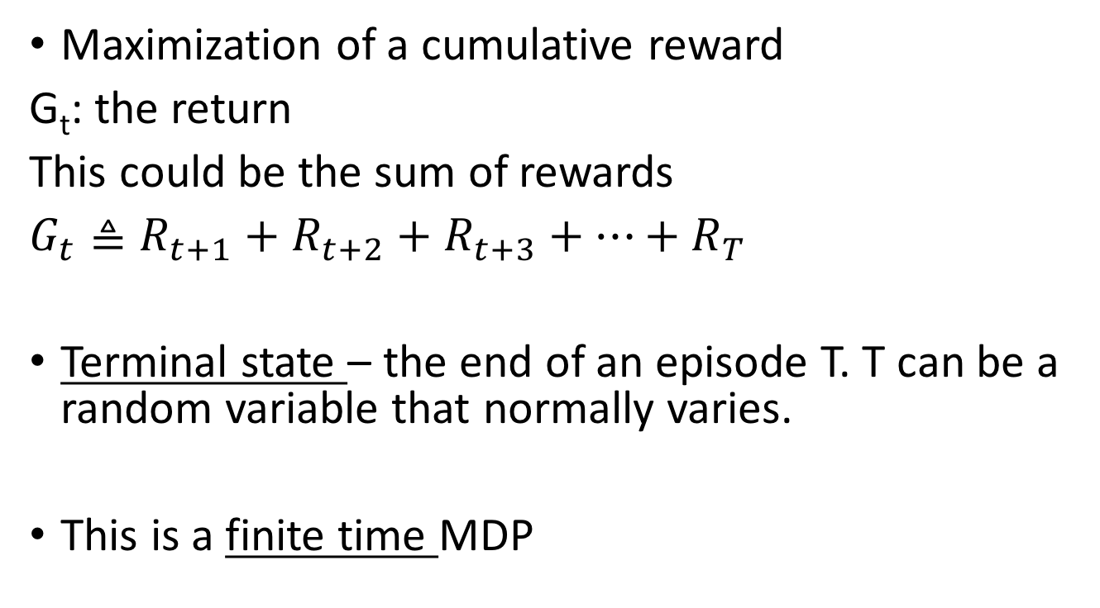
Goals and Rewards
Maximization of a cumulative reward
G_{t}: the return
This could be the sum of rewards
$G_{t}≜R_{t+1}+R_{t+2}+R_{t+3}+…+R_{T}$
Terminal state – the end of an episode T. T can be a random variable that normally varies.
This is a finite time MDP
T is the final timestep

Slide 15
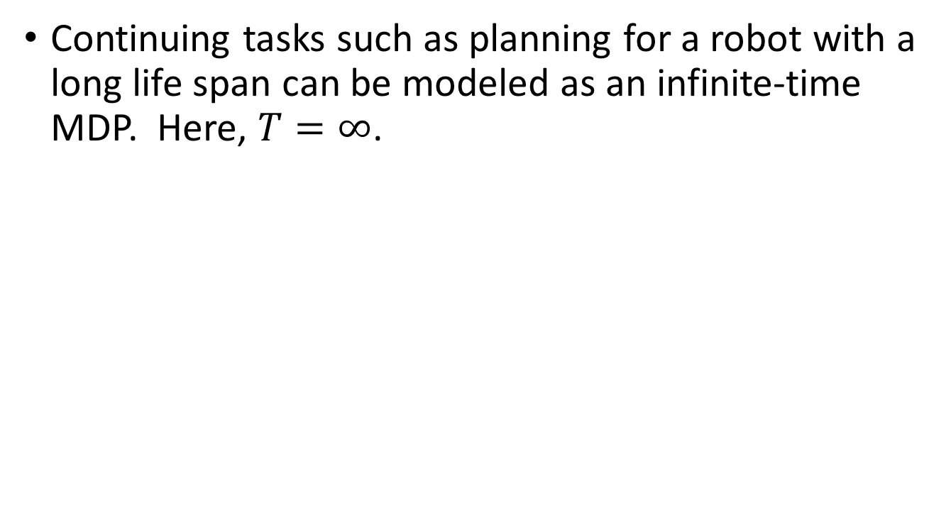
Infinite Time MDPs
Continuing tasks such as planning for a robot with a long life span can be modeled as an infinite-time MDP. Here, $T=∞$.
Was the Mars Exploration Rover example an infinite time model or finite time?
What about a game such as checkers?

Slide 16
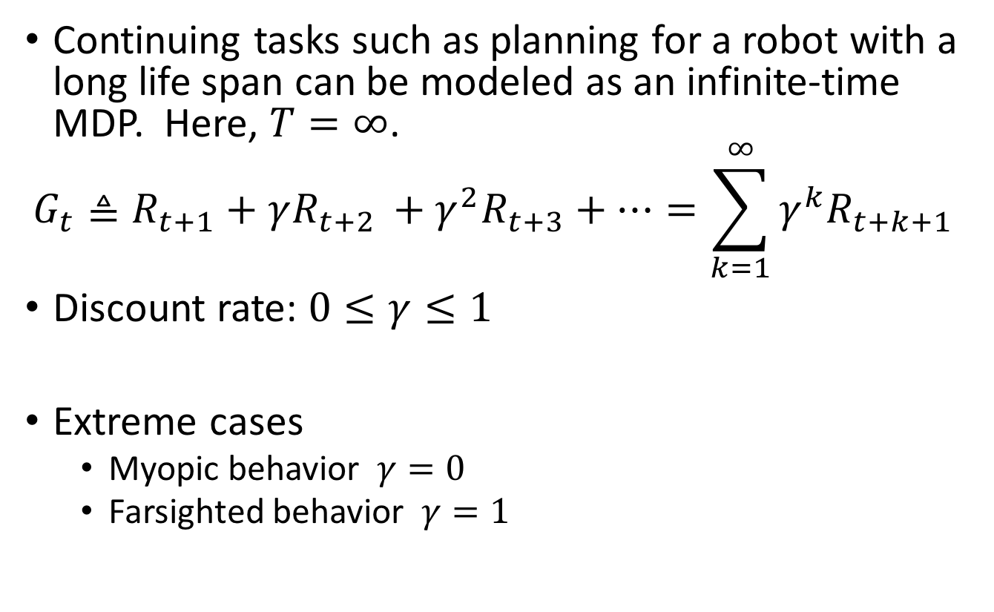
Infinite Time MDPs
Continuing tasks such as planning for a robot with a long life span can be modeled as an infinite-time MDP. Here, $T=∞$.
$$G_{t}≜R_{t+1}+γR_{t+2 }+γ^{2}R_{t+3}+…=\sum_{k=1}^{∞}{γ^{k}R_{t+k+1}}$$
Discount rate: $0≤γ≤1$
Extreme cases
Myopic behavior $γ=0$
Farsighted behavior $γ=1$
What does this mean intuitively? Can you think of examples? Like investment portfolios…?

Slide 17
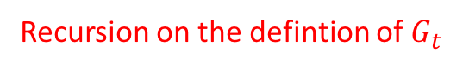
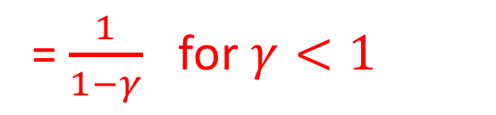
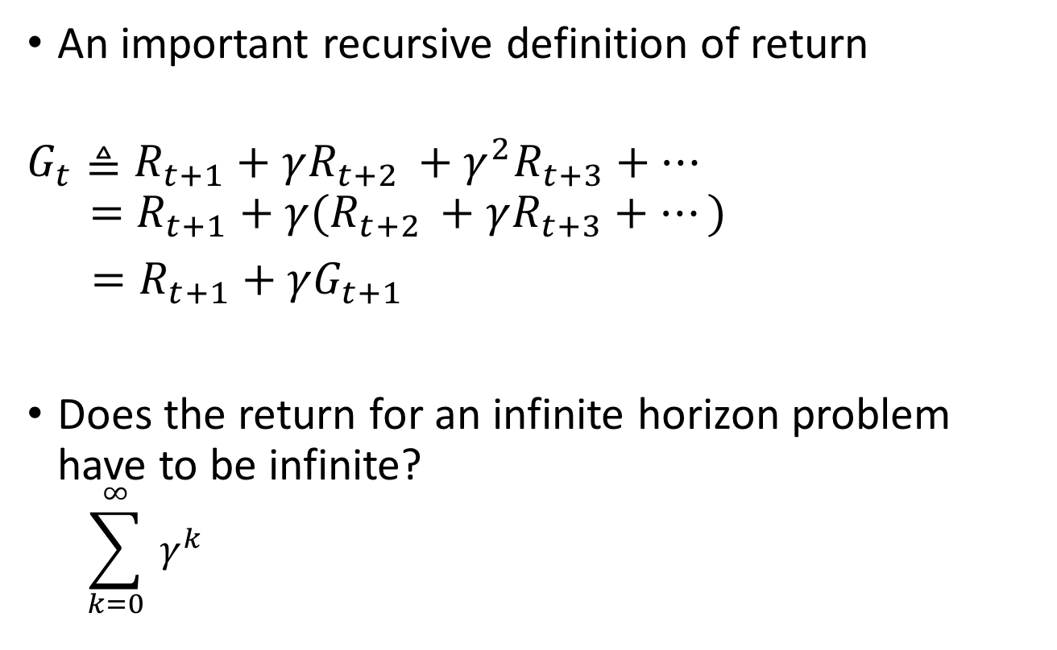
The Return (or Cumulative Reward)
An important recursive definition of return
$$G_{t}≜R_{t+1}+γR_{t+2 }+γ^{2}R_{t+3}+…$$
$$=R_{t+1}+γ(R_{t+2 }+γR_{t+3}+…)$$
$=R_{t+1}+γG_{t+1}$
Does the return for an infinite horizon problem have to be infinite?
$$\sum_{k=0}^{∞}{ γ^{k}}$$
Recursion on the defintion of $G_{t}$
= $\frac{1}{1−γ}$ for $γ<1$

Slide 18
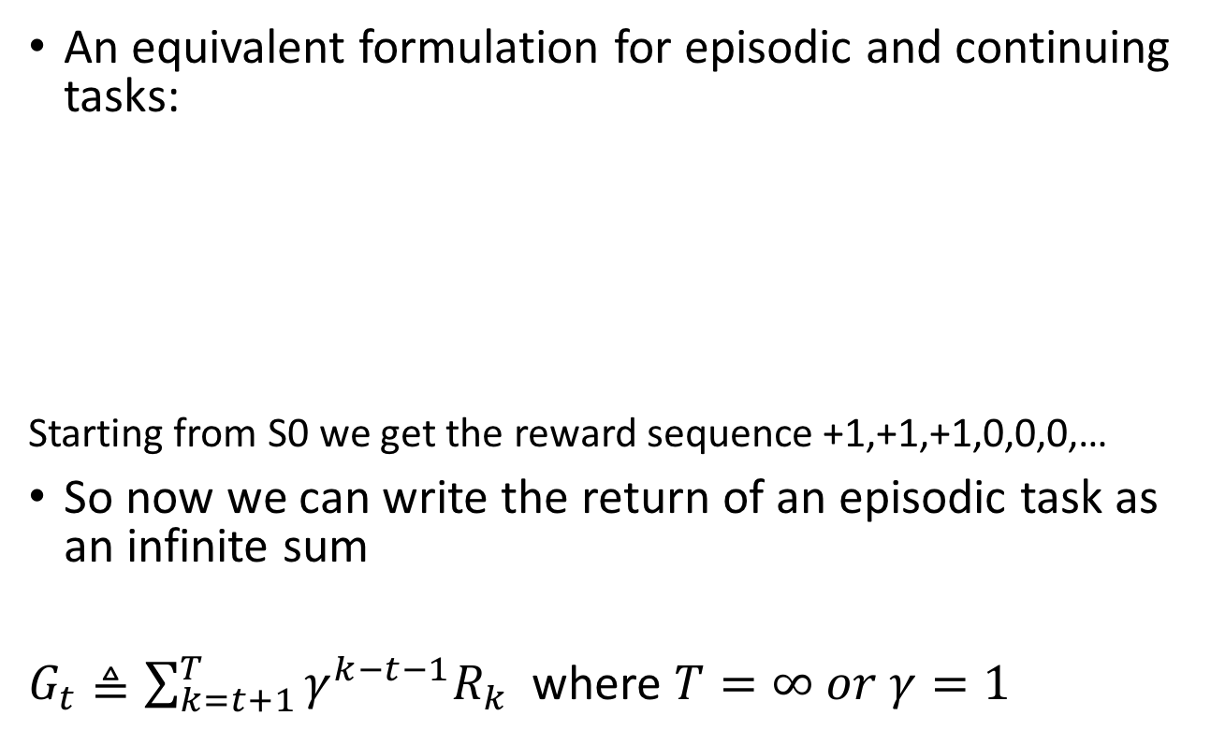
A Unified Notation
An equivalent formulation for episodic and continuing tasks:
Starting from S0 we get the reward sequence +1,+1,+1,0,0,0,…
So now we can write the return of an episodic task as an infinite sum
$G_{t}≜\sum_{k=t+1}^{T}{γ^{k−t−1}R_{k}}$ where $T=∞ or γ=1$
[Sutton and Barto text section 3.4]
But not both! Why?

Slide 19
Example: A Maze
States S={1,2,…,18}
Actions A={N,E,S,W}
Partially expanded state space?
Why is the reward negative?
How to solve for the best path?
BFS?
A*?
Dynamic Programming!

Slide 20
Some Notes…
We have presented some of the ideas that reinforcement learning builds off of
Goals of reinforcement learning are that the agent should figure out which actions to take next in order to maximize future payoff (accumulation of rewards)
This formulation can teach agent behaviors by correctly formulating the problem and encoding the rewards
Maximize rewards = Minimize cost! (DP often minimizes cost)

Slide 21
Next Time…
HW 2 due Friday (Sept 14th at 5pm)
Introduction to Dynamic Programming
Readings will be posted on Blackboard → special access made possible by Prof. Dimitri Bertsekas to his Dynamic Programming and Optimal Control text!

